Slide 1
Machine learning based Phase I and II drug metabolism prediction
Student - Srijan Verma Supervisor - Dr. Suman Sirimulla

Slide 2

Why ?

Slide 3
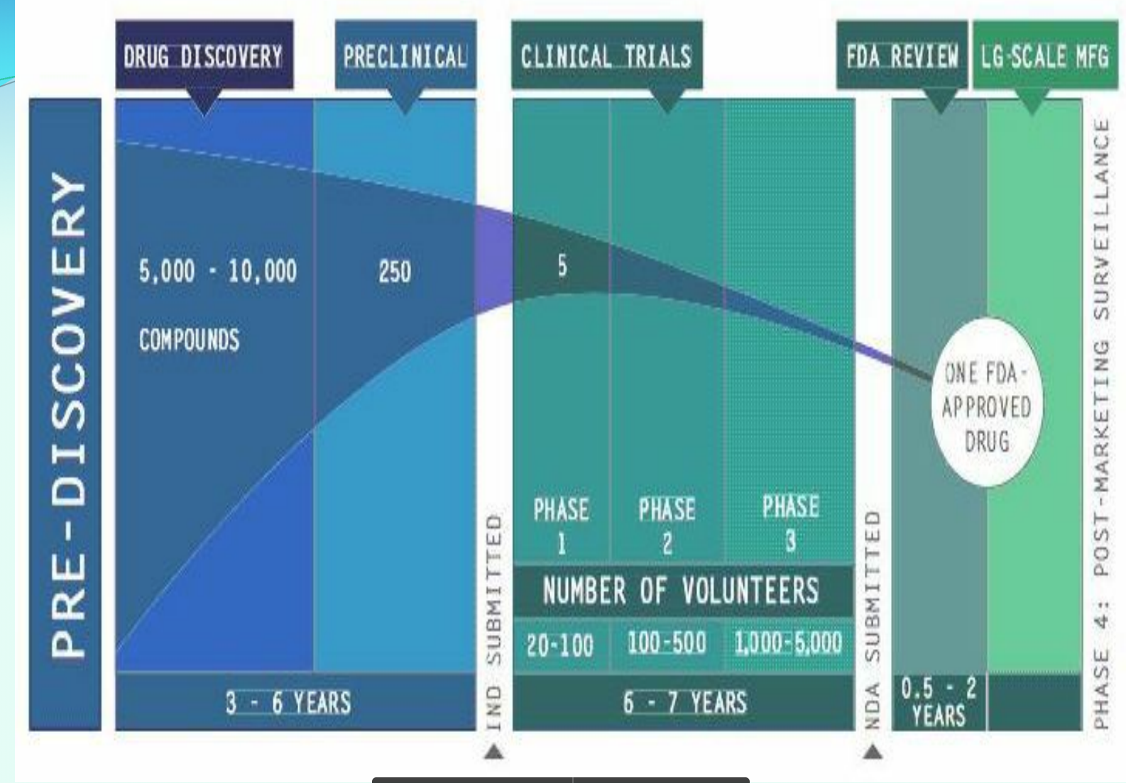

Slide 4
Life cycle of a potential drug
Start with 10,000 compounds.
Only 1 makes it to the end. Because the rest of the drugs are either not efficacious OR are toxic.
Costs $2.5 billion for one drug.
FDA approves ~40 drugs every year.
Total cost = 40 X 2.5 = $100 billion

Slide 5
Can we reduce the cost somehow ?

Slide 6

Yes we can !

Slide 7
Journey of an oral drug
DRUG (oral route) ---> Liver (drug gets broken down/metabolised) ---> systemic circulation (action!)

Slide 8
DRUG (oral route) ---> Liver (metabolised less/no metabolism occurs ---> toxic to body!

Slide 9
GOAL
Predict how much the drug will get metabolised in order to solve the toxicity

Slide 10

Guess the movie!

Slide 11


Slide 12


Slide 13

Or someone who knows machine learning

Slide 14
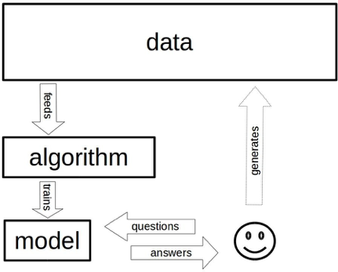
Workflow of ML task

Slide 15
